Slide 1
create abundance
‘tis the season of giving
Together Women Rise
December 1, 2021
Cheryl R. Holland, CFP®, CFBA
abacusplanninggroup.com

Slide 3
from the simple to the complex
| cash
| appreciated stock
| qualified charitable distribution (QCD)
| donor advised fund
| legacy giving
abacusplanninggroup.com

Slide 4
what’s new in 2021
| $300 above the line deduction ($600 for couples)
| cash contributions eligible for up to 100% of your adjusted gross income in 2020 for individuals (up from 60%)
| cash contributions eligible for up to 25% of taxable income for corporations
| five-year carry forward for cash gifts in excess of 100% of your adjusted gross income
abacusplanninggroup.com
Notes:
Three kinds of checklists: 1) monkey can do it; 2) rarely used/high risk; 3) Thinking points reflecting accumulated wisdom and experiences.

Slide 5
gifting long-term appreciated securities
| make a gift and eliminate your tax liability
| rebalancing your portfolio
| concentrated exposure to a single stock
| emotional attachment? gift and buy again
| five-year carry forward for security gifts in excess of 30% of your adjusted gross income
abacusplanninggroup.com
Notes:
Three kinds of checklists: 1) monkey can do it; 2) rarely used/high risk; 3) Thinking points reflecting accumulated wisdom and experiences.

Slide 6
celebrating 70.5 with
abacusplanninggroup.com

Slide 7
a qualified charitable distribution (QCD)
| must be 70.5
| Individual Retirement Accounts
| $100,000 maximum annual distribution
| must be payable directly to a charity
| QCD versus a gift of appreciated securities
abacusplanninggroup.com
Notes:
CRH to provide a “walk out the door” to-do list
Reference Day 1

Slide 8
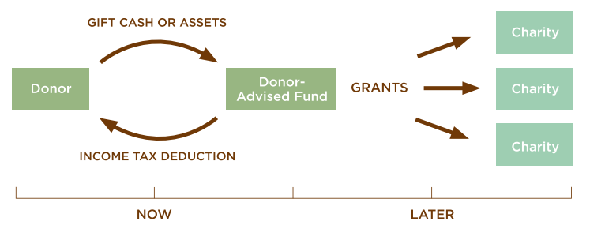
the donor advised fund
abacusplanninggroup.com

Slide 9
donor-advised funds (daf)
| donate cash, stock or other assets
| immediate tax deduction
| support charities now or over time
| grow your donation, tax-free
| QCD versus a gift to a DAF
abacusplanninggroup.com
Notes:
CRH to provide a “walk out the door” to-do list
Reference Day 1

Slide 10
and when I die

Slide 11
legacy planning
| beneficiary designation of retirement plans
| consider a tithe or split with the children of the world
| charitable remainder trust
| write an ethical will
abacusplanninggroup.com
Notes:
CRH to provide a “walk out the door” to-do list
Reference Day 1

Slide 12
Call to action
| tomorrow – time, talent, treasure, ties
| pick three items from the resource list
| consult with your tax advisors
| block time on your calendar [ and then double it ] to discuss your vision and values with family or friends
abacusplanninggroup.com
Notes:
CRH to provide a “walk out the door” to-do list
Reference Day 1

Slide 13
Resources
| Gender Matters in Philanthropy philanthropy.iupui.edu/institutes/womens-philanthropy-institute/index.html
| Giving by and for Women: Understanding high-net-worth donors’ support for women and girls IUPUI Women’s Philanthropy Institute
| Fidelity Charitable Gift Fund
| The Forever Letter: Writing What We Believe for Those We Love: Zaiman, Elana
| Money and the Meaning of Life: Jacob Needleman
| Money is power. And women need more of both. nytimes.com/2018/03/10/sunday-review/women-money-politics-power.html
| Raising Financially Fit Kids: Joline Godfrey
| Schwab Charitable Fund
| The Opposite of Spoiled: Ron Lieber
| Vanguard Charitable Endowment Fund
| Women, Wealth and Giving: The Virtuous Legacy of the Boom Generation Margaret May Damen and Niki Nicastro MuCuistion
| 21/64 Next Generation Philanthropy: 2164.net
abacusplanninggroup.com
Notes:
CRH to provide a “walk out the door” to-do list
Reference Day 1

Slide 14
